Slide 1
Lecture 21: Searching and Sorting (Part II)
Copyright (c) Pearson 2013. All rights reserved.

Slide 2
Sorting
sorting: Rearranging the values in an array or collection into a specific order (usually into their "natural ordering").
one of the fundamental problems in computer science
can be solved in many ways:
there are many sorting algorithms
some are faster/slower than others
some use more/less memory than others
some work better with specific kinds of data
some can utilize multiple computers / processors, ...
comparison-based sorting : determining order by comparing pairs of elements:
<, >, compareTo, …

Slide 3
Sorting algorithms
bubble sort: swap adjacent pairs that are out of order
selection sort: look for the smallest element, move to front
insertion sort: build an increasingly large sorted front portion
merge sort: recursively divide the array in half and sort it
heap sort: place the values into a sorted tree structure
quick sort: recursively partition array based on a middle value

Slide 4
Sorting algorithms
bubble sort: swap adjacent pairs that are out of order
selection sort: look for the smallest element, move to front
insertion sort: build an increasingly large sorted front portion
merge sort: recursively divide the array in half and sort it
heap sort: place the values into a sorted tree structure
quick sort: recursively partition array based on a middle value

Slide 5
Selection sort
selection sort: Orders a list of values by repeatedly putting the smallest or largest unplaced value into its final position.
The algorithm:
Look through the list to find the smallest value.
Swap it so that it is at index 0.
Look through the list to find the second-smallest value.
Swap it so that it is at index 1.
...
Repeat until all values are in their proper places.

Slide 6
Selection sort example
Initial array:
After 1st, 2nd, and 3rd passes:
index | 0 | 1 | 2 | 3 | 4 | 5 | 6 | 7 | 8 | 9 | 10 | 11 | 12 | 13 | 14 | 15 | 16
value | 22 | 18 | 12 | -4 | 27 | 30 | 36 | 50 | 7 | 68 | 91 | 56 | 2 | 85 | 42 | 98 | 25
index | 0 | 1 | 2 | 3 | 4 | 5 | 6 | 7 | 8 | 9 | 10 | 11 | 12 | 13 | 14 | 15 | 16
value | -4 | 18 | 12 | 22 | 27 | 30 | 36 | 50 | 7 | 68 | 91 | 56 | 2 | 85 | 42 | 98 | 25
index | 0 | 1 | 2 | 3 | 4 | 5 | 6 | 7 | 8 | 9 | 10 | 11 | 12 | 13 | 14 | 15 | 16
value | -4 | 2 | 12 | 22 | 27 | 30 | 36 | 50 | 7 | 68 | 91 | 56 | 18 | 85 | 42 | 98 | 25
index | 0 | 1 | 2 | 3 | 4 | 5 | 6 | 7 | 8 | 9 | 10 | 11 | 12 | 13 | 14 | 15 | 16
value | -4 | 2 | 7 | 22 | 27 | 30 | 36 | 50 | 12 | 68 | 91 | 56 | 18 | 85 | 42 | 98 | 25

Slide 7
Selection sort code
// Rearranges the elements of a into sorted order using
// the selection sort algorithm.
public static void selectionSort(int[] a) {
for (int i = 0; i < a.length - 1; i++) {
// find index of smallest remaining value
int min = i;
for (int j = i + 1; j < a.length; j++) {
if (a[j] < a[min])
min = j;
}
// swap smallest value its proper place, a[i]
swap(a, i, min);
}
}
public static void swap(int[] a, int i, int j)
{
int temp=a[i];
a[i]=a[j];
a[j]=temp;}

Slide 8
Insertion Sort
insertion sort: Shift each element into a sorted sub-array
faster than selection sort (examines fewer values)
index | 0 | 1 | 2 | 3 | 4 | 5 | 6 | 7 | 8 | 9 | 10 | 11 | 12 | 13 | 14 | 15 | 16
value | -4 | 12 | 18 | 22 | 27 | 30 | 36 | 50 | 7 | 68 | 91 | 56 | 2 | 85 | 42 | 98 | 25
sorted sub-array (indexes 0-7)
7
Notes:
A lot of 143 students implement a kind of insertion sort on their SortedIntList add operation.

Slide 9
Insertion Sort Algorithm
Check element.
If larger than the previous element, leave it.
If smaller than the previous element, shift previous larger elements down until you reach a smaller element (or beginning of array).
Insert element.

Slide 10

Insertion Sort Algorithm
64 54 18 87 35
54 less than 64
Shift down and insert 54
54 64 18 87 35(1st pass)
18 less than 64
18 less than 54
Shift down and insert 18
18 54 64 87 35(2nd pass)
87 greater than 64
Go to next element
18 54 64 87 35(3rd pass)
35 less than 87
35 less than 64
35 less than 54
35 greater than 18
Shift down and insert 35
18 35 54 64 87(4th pass)

Slide 11
Merge sort
merge sort: Repeatedly divides the data in half, sorts each half, and combines the sorted halves into a sorted whole.
The algorithm:
Divide the list into two roughly equal halves.
Sort the left half.
Sort the right half.
Merge the two sorted halves into one sorted list.
Often implemented recursively.
An example of a "divide and conquer" algorithm.
Invented by John von Neumann in 1945

Slide 12
Merge sort example
index | 0 | 1 | 2 | 3 | 4 | 5 | 6 | 7
value | 22 | 18 | 12 | -4 | 58 | 7 | 31 | 42
split
22 | 18 | 12 | -4
58 | 7 | 31 | 42
split
split
22 | 18
12 | -4
58 | 7
31 | 42
split
split
split
split
22
18
12
-4
58
7
31
42
merge
merge
merge
merge
18 | 22
-4 | 12
7 | 58
31 | 42
merge
merge
-4 | 12 | 18 | 22
7 | 31 | 42 | 58
merge
-4 | 7 | 12 | 18 | 22 | 31 | 42 | 58

Slide 13
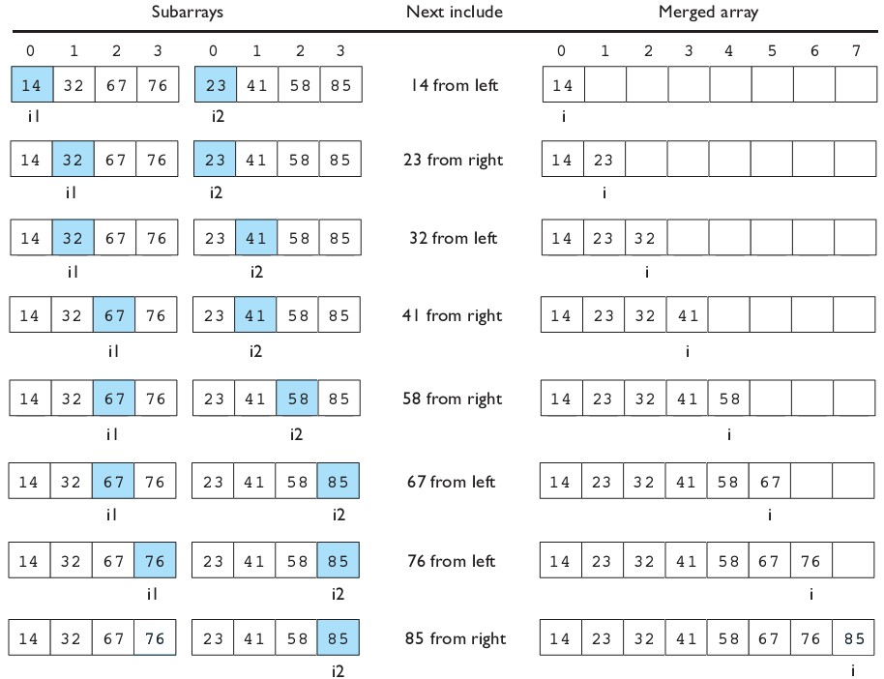
Merging sorted halves

Slide 14
Merge halves code
// Merges the left/right elements into a sorted result.
// Precondition: left/right are sorted
public static void merge(int[] result, int[] left,
int[] right) {
int i1 = 0; // index into left array
int i2 = 0; // index into right array
for (int i = 0; i < result.length; i++) {
if (i2 >= right.length ||
(i1 < left.length && left[i1] <= right[i2])) {
result[i] = left[i1]; // take from left
i1++;
} else {
result[i] = right[i2]; // take from right
i2++;
}
}
}

Slide 15
Merge sort code
// Rearranges the elements of a into sorted order using
// the merge sort algorithm (recursive).
public static void mergeSort(int[] a) {
if (a.length >= 2) {
// split array into two halves
int[] left = Arrays.copyOfRange(a, 0, a.length/2);
int[] right = Arrays.copyOfRange(a, a.length/2, a.length);
// sort the two halves
mergeSort(left);
mergeSort(right);
// merge the sorted halves into a sorted whole
merge(a, left, right);
}
}

Slide 16
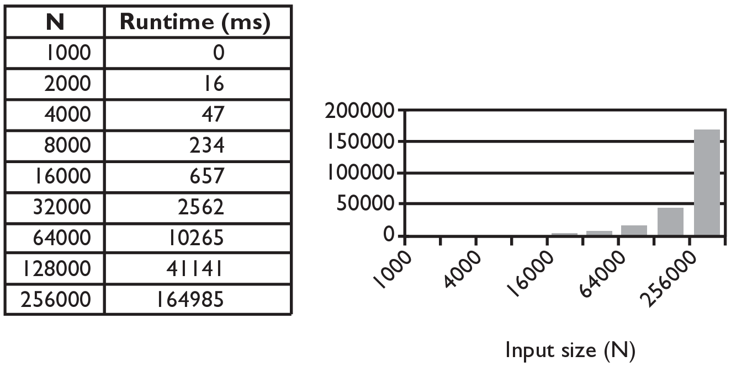
Selection sort runtime (Fig. 13.6)
What is the complexity class (Big-Oh) of selection sort?

Slide 17
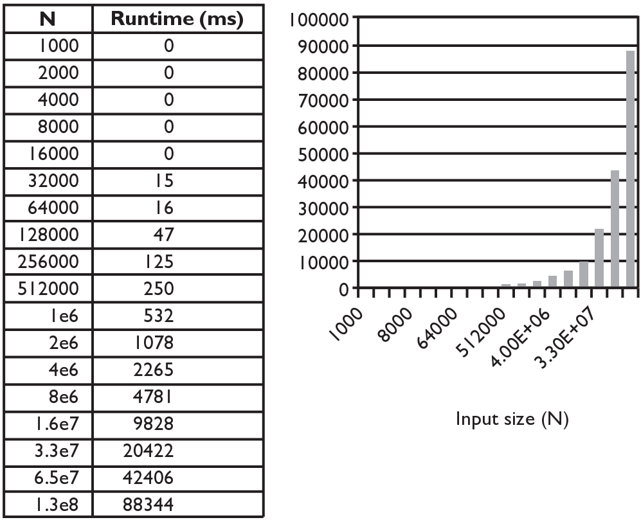
Merge sort runtime
What is the complexity class (Big-Oh) of merge sort?

Slide 18
Lab 2
Write the methods selectionSort and swap.
public static void selectionSort(int[] a)
{…}
public static void swap(int[] a, int i, int j)
{…}

